Slide 1
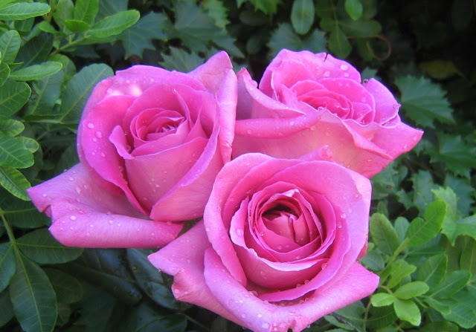
WELCOME

Slide 2
MD.SAYFUL ISLAM
Asst. Teacher
Jogswar High School
Subject: English
Paper : One
Class : Eight
Unit : Two
Lesson : One
Topic : Good Food
Duration: 50 Mins.

Slide 3
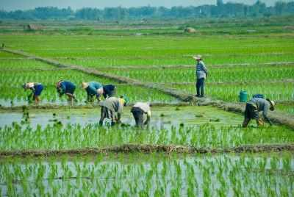
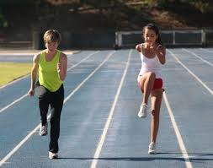
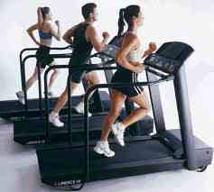
What are they doing?
How can they get energy?

Slide 4
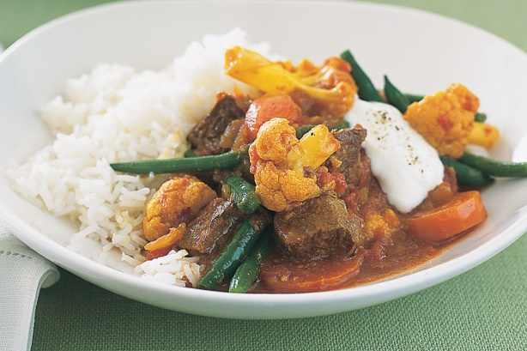
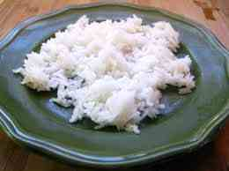

What is food?
Food is any substance that people or animals eat or drink and makes our body work ,grow and repair itself.

Slide 5
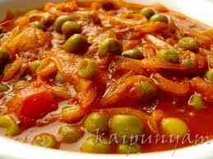
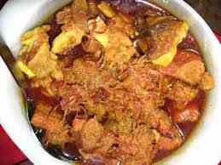
What type of food do we need?
GOOD FOOD

Slide 6
LEARNING OUTCOMES:
By the end of lesson SS will be able…………………
To identify good food
To define new words
To ask and answer question
To talk about the picture.

Slide 7
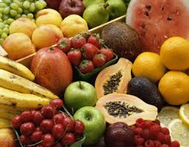
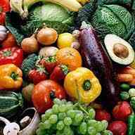
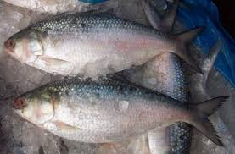
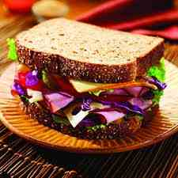
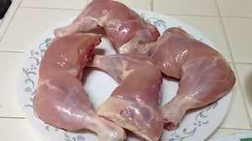
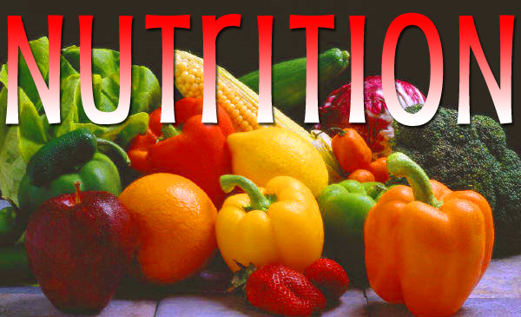
What is good food?
Good food means NUTRITIOUS food.

Slide 8
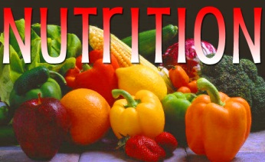
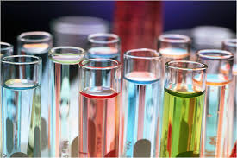
VOCABULARY
WORD
MEANING
PICTURE
Nutritious
Nourishing
Substance
A particular type of thing or matter

Slide 9
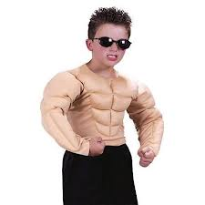
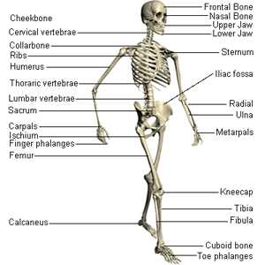
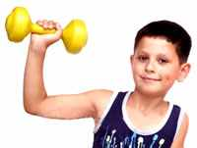
Physical
Bodily
Structure
A frame
Healthy
Having good health

Slide 10
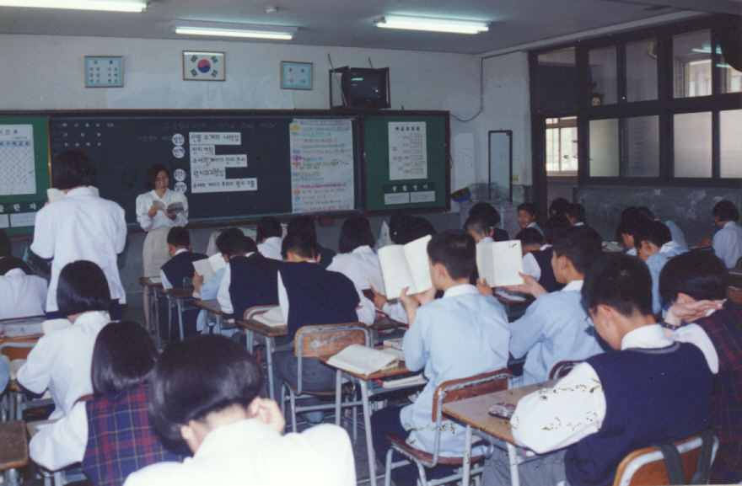
What are they doing in the class room?
P/W

Slide 11
Now read the text and answer the following questions:
I/W & P/W
1.What is Ms Rehena talking about?
2.Why do we eat food?
3.What is meant by nutritious food?
4.How much food does a person need to eat a day?
5.Does everyone need the same amount of food ? Why?

Slide 12
ANSWER
1.Ms Rehena is talking about food.
2.We eat food so that we can grow properly and stay healthy.
3.Nutritious food is a food that contains natural substances that our body needs to grow properly and stay healthy.
4.A person needs to eat a certain amount of food that his body requires.
5.No,everyone does not need the same amount of food.

Slide 13
Complete these sentences :
I/W&P/W
1.We should eat good food to .........
2.We should not eat more than………
3.Eating too much food is not…………
4.Good food means ……………
Stay healthy.
Our body needs.
Good for health.
Nutritious food.

Slide 14
EVALUATION
Why do we eat food?
What is meant by nutritious food?
How much food does a person need to eat a day?

Slide 15
HOME WORK
Write a paragraph about GOOD FOOD.

Slide 16
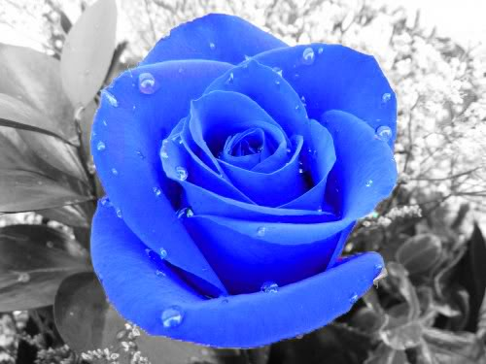
THANKS

